Slide 1










Unit 12
Those are our computers.
Lesson 4

Slide 2





Welcome, Students!

Slide 3





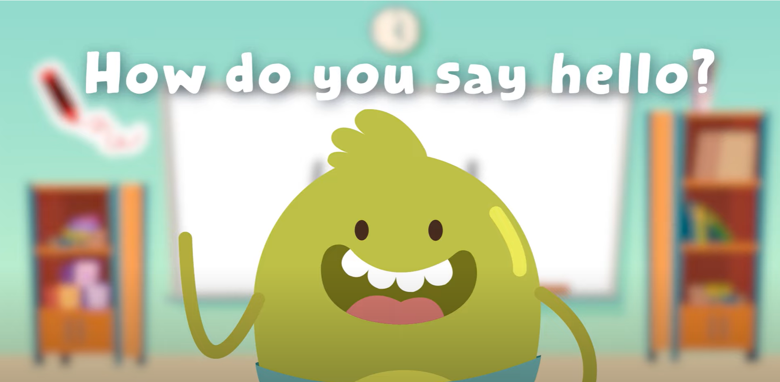




Hello song!

Slide 4






Give me Five

Slide 5






Game

Slide 6








Good job!

Slide 7







Listen and Point

Slide 8
Listen and Repeat

Slide 9
Good job!

Slide 10
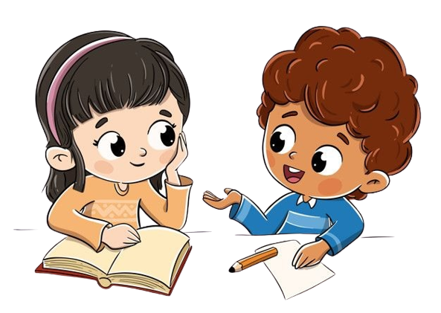
Work in groups
Point and Say

Slide 11
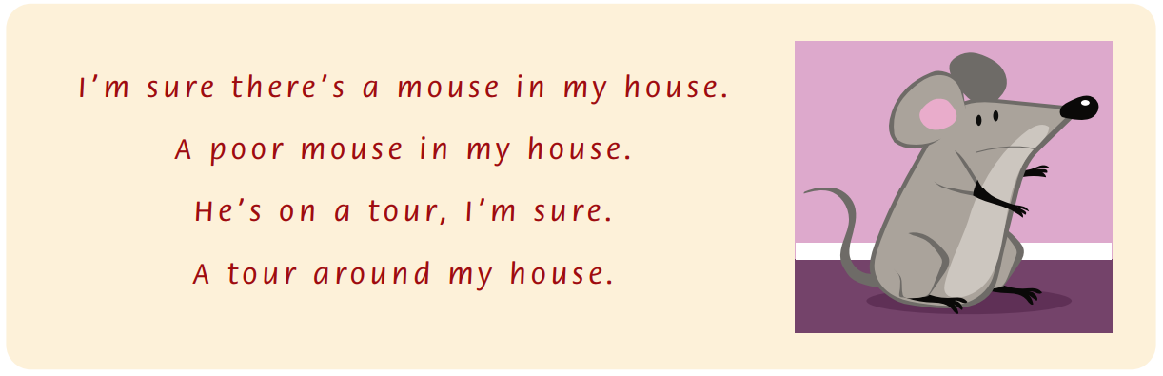
Listen and Point
Notes:
Look at your classroom.

Slide 12
Listen and Repeat
Notes:
Look at your classroom.

Slide 13
Listen and Chant
Notes:
Look at your classroom.

Slide 14
Good job!

Slide 15
Work in groups
Point and Say
Notes:
Read the chant again. Say the words with oor, our and ou.

Slide 16
Good job!

Slide 17
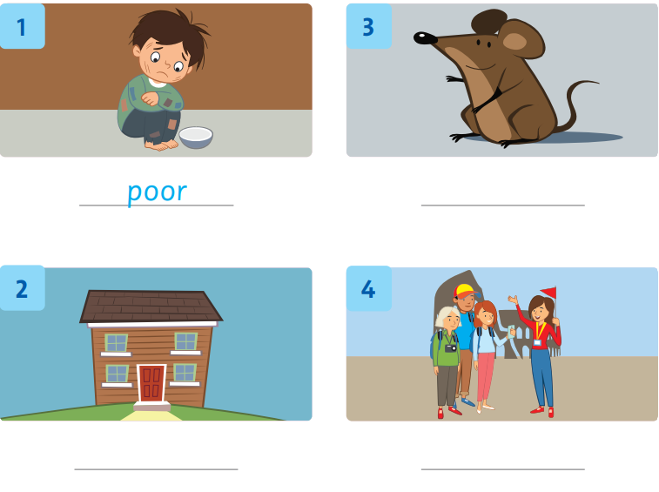
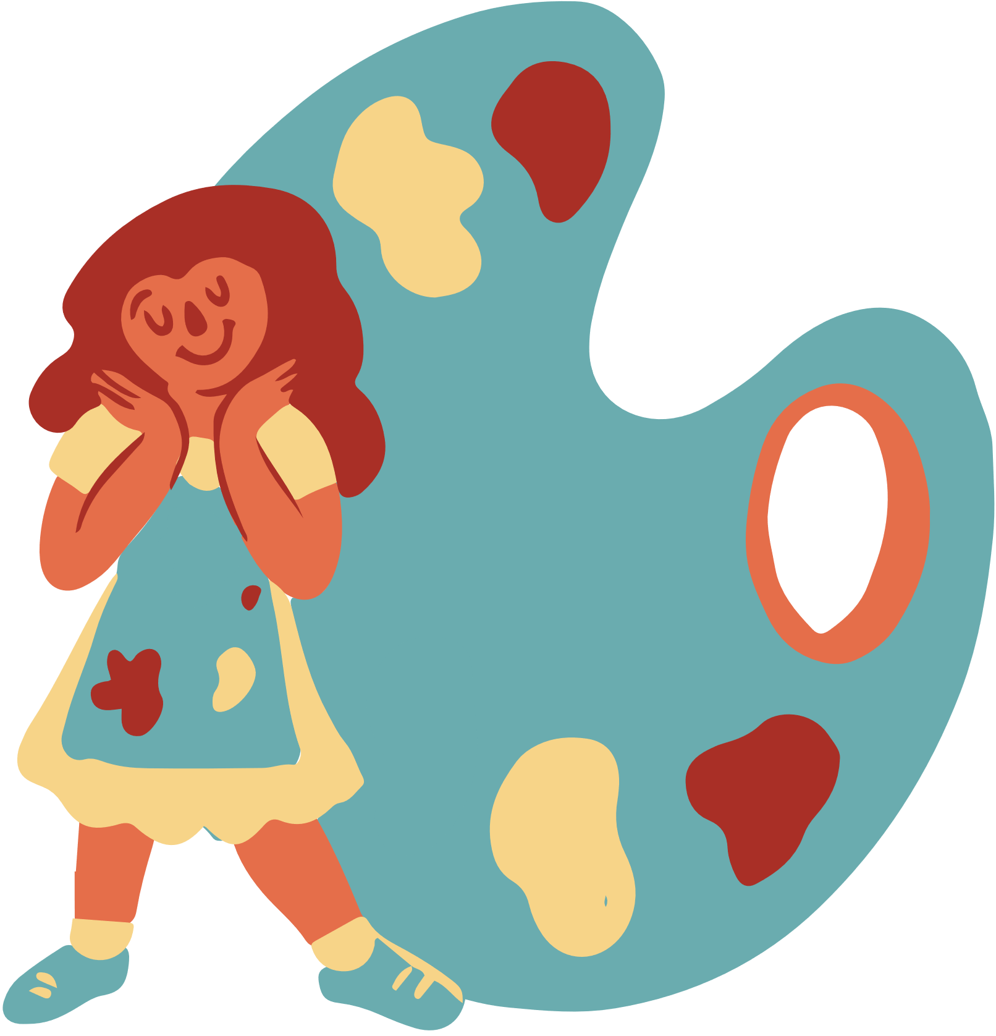
Look, Write and Say
mouse
house
tour

Slide 18
Good job!

Slide 19
Game

Slide 20
Good job!

Slide 21
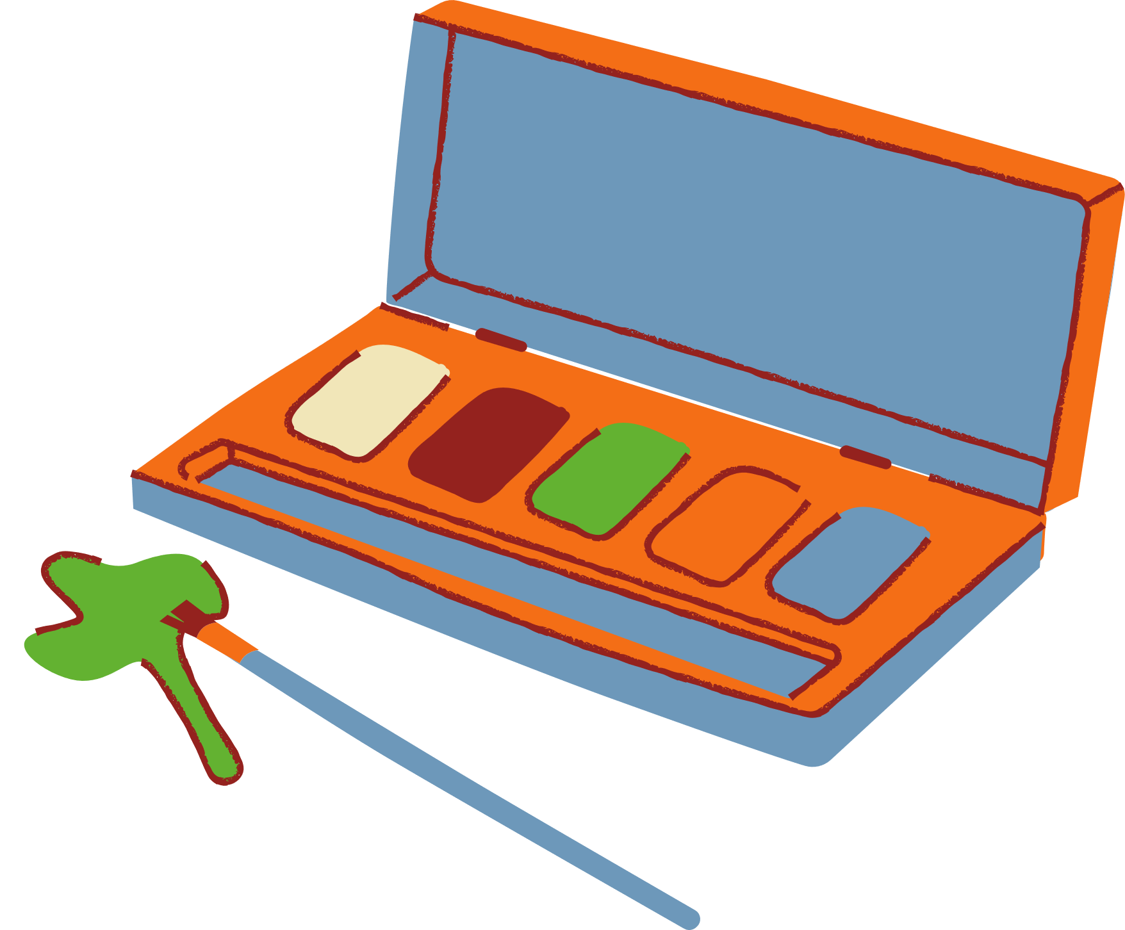
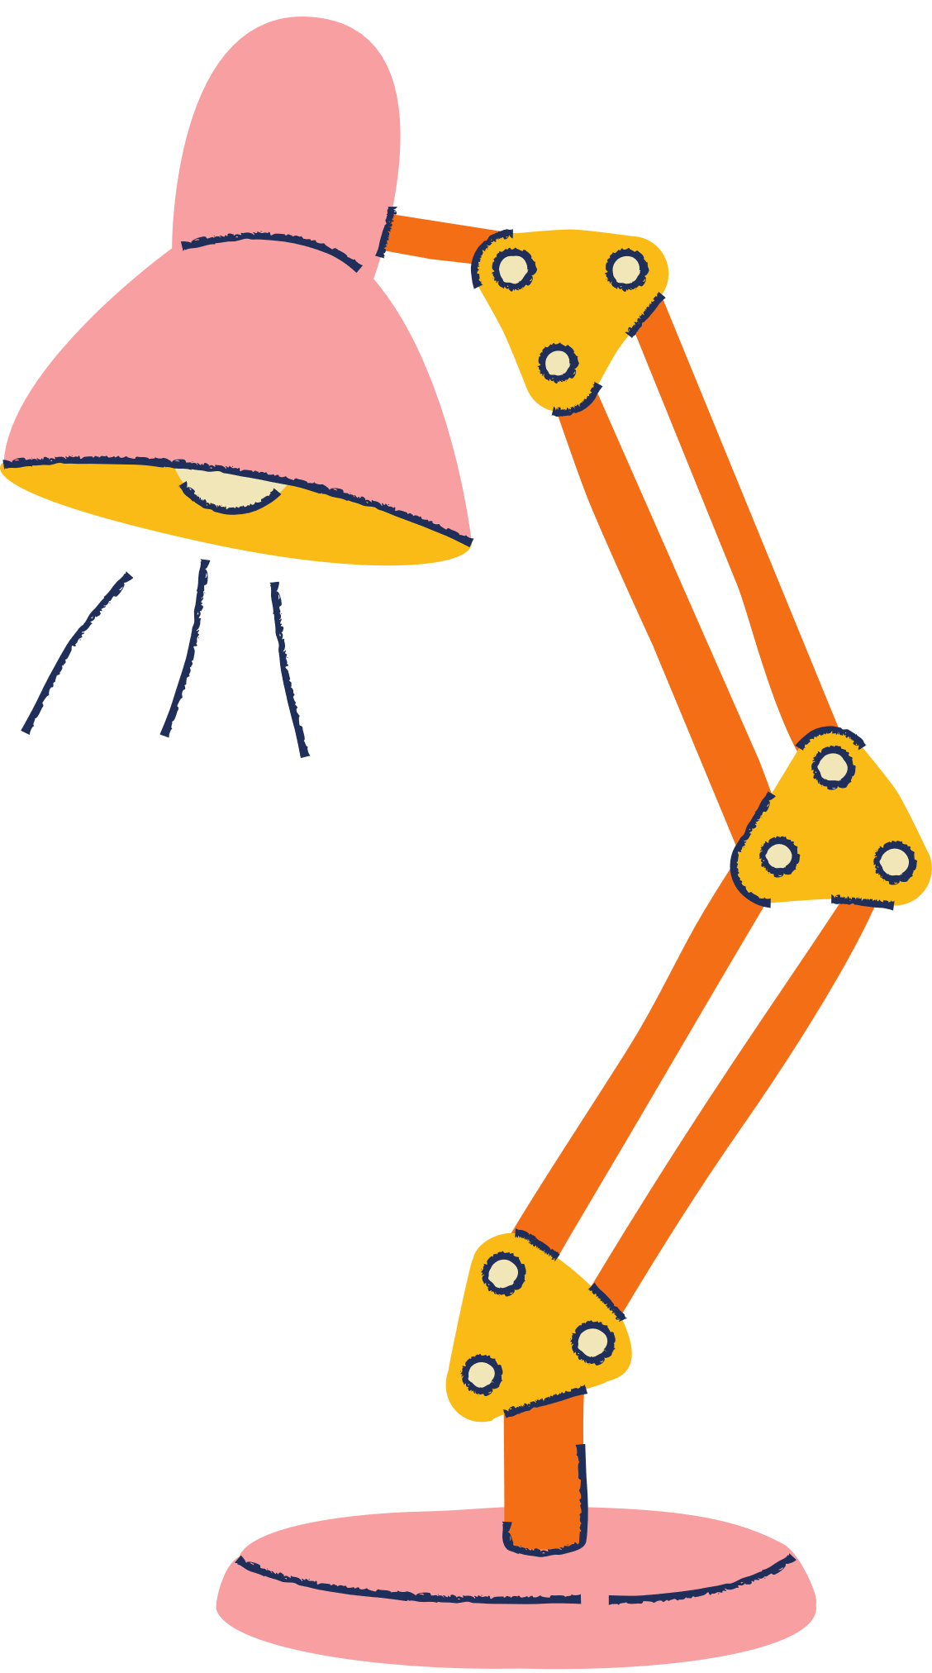





Homework
Workbook – page 91
sachso.edu.vn

Slide 22




THANK YOU!

